Slide 1


CSE 470 – Project Scheduling
BRAC University

Slide 2




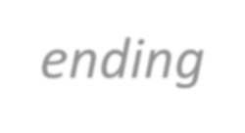
PROJECT SCHEDULING
It is part of project management within the Planning phase of
the Systems Development Life Cycle.
Project Scheduling: Allocate resources to execute all activities in the project.
Project: Set of activities or tasks with a clear beginning and ending points. The amount of available resources (time, personnel and budget) to carry out the activities is usually limited.
5

Slide 3




CPM – CRITICAL PATH METHOD
Objectives:
Establish beginning, ending and duration of each activity in the project.
Calculate overall completion time of the project given the
amount of usually limited resources.
Guide the allocation of resources other than time such as staff and budget.
6

Slide 4
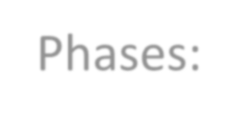

CPM – CRITICAL PATH METHOD
Phases:
Define activities or tasks according to the project objectives.
A task is an individual unit of work with a clear beginning and a clear end.
Identify precedence relationships or dependencies
Estimate time required to complete each task.
Draw the estimation diagram.
Apply CPM to calculate earliest and latest starting times, earliest and latest completion times, slack times, critical path etc.
Construct a GANTT chart.
Reallocate resources and resolve if necessary.
Continuously monitor/revise the time estimates along the project duration.
7

Slide 5
CPM – CRITICAL PATH METHOD
It is determined by adding the times for the activities in each sequence.
CPM determines the total calendar time required for the project.
Activities are 2 types – Critical and Non-Critical Task.
Critical activities can not be delayed.
If non-critical activities are speed up or slow down (within limits), the total project time does not change.

Slide 6
CPM – CRITICAL PATH METHOD
ES | A | EF
LS | t | LF
ES – Activity earliest start time
LS – Activity latest start time
EF – Activity earliest finishing time
LF – Activity latest finishing time
A: Activity identification (node)
t(i): Activity duration of node i
P(i): set of predecessor nodes to node i
S(i): set of successor nodes to node i
20

Slide 7
CPM – CRITICAL PATH METHOD
Slack Time / Total Float – Maximum activity delay time. The amount of time that the starting date of a activity can be delayed without delaying the project deadline is called slack-time.
Free Float: is the amount of time that an activity can be delayed without delaying the early start date of any successor activity.

Slide 8
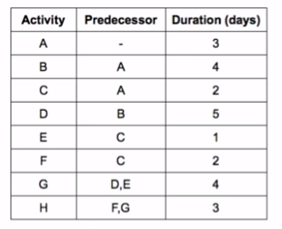
ES | A | EF
LS | t | LF

Slide 9
 | D
 | B
 | G
 | A
 | E
 | H
 | C
 | F

Slide 10
Assign Durations
 | D
 | B
 | G
 | A
 | 3
 | E
 | H
 | C
 | F

Slide 11
Assign Durations
 | D
 | B
 | 4
 | G
 | A
 | 3
 | E
 | H
 | C
 | F

Slide 12
Assign Durations
 | D
 | 5
 | B
 | 4
 | G
 | 4
 | A
 | 3
 | E
 | 1
 | H
 | 3
 | C
 | 2
 | F
 | 2

Slide 13
Calculate ES
ES(i) = Max{EF(j), j in P(i)}
ES(A) = 0, as no preceding node
 | D
 | 5
 | B
 | 4
 | G
 | 4
0 | A
 | 3
 | E
 | 1
 | H
 | 3
 | C
 | 2
 | F
 | 2

Slide 14
Calculate EF
EF(i) = =ES(i)+t(i)
EF(A) = =ES(A)+t(A) = 0+3 = 3
 | D
 | 5
 | B
 | 4
 | G
 | 4
0 | A | 3
 | 3
 | E
 | 1
 | H
 | 3
 | C
 | 2
 | F
 | 2

Slide 15
Calculate ES and EF for all nodes
 | D
 | 5
3 | B | 7
 | 4
 | G
 | 4
0 | A | 3
 | 3
 | E
 | 1
 | H
 | 3
 | C
 | 2
 | F
 | 2

Slide 16
Calculate ES
Calculate EF
 | D
 | 5
3 | B | 7
 | 4
 | G
 | 4
0 | A | 3
 | 3
 | E
 | 1
 | H
 | 3
3 | C | 5
 | 2
 | F
 | 2

Slide 17
Calculate ES
Calculate EF
7 | D | 12
 | 5
3 | B | 7
 | 4
 | G
 | 4
0 | A | 3
 | 3
 | E
 | 1
 | H
 | 3
3 | C | 5
 | 2
 | F
 | 2

Slide 18
Calculate ES
Calculate EF
7 | D | 12
 | 5
3 | B | 7
 | 4
 | G
 | 4
0 | A | 3
 | 3
5 | E | 6
 | 1
 | H
 | 3
3 | C | 5
 | 2
 | F
 | 2

Slide 19
Calculate ES and EF
Node G has 2 proceeding tasks – Node D and E
7 | D | 12
 | 5
3 | B | 7
 | 4
 | G
 | 4
0 | A | 3
 | 3
5 | E | 6
 | 1
 | H
 | 3
3 | C | 5
 | 2
 | F
 | 2

Slide 20
ES(G) = Max{EF(j), j in P(G)}
= Max {EF(D), EF(E)}
= Max{12,6}
=12
7 | D | 12
 | 5
3 | B | 7
 | 4
12 | G | 16
 | 4
0 | A | 3
 | 3
5 | E | 6
 | 1
 | H
 | 3
3 | C | 5
 | 2
 | F
 | 2

Slide 21
Calculate ES
Calculate EF
7 | D | 12
 | 5
3 | B | 7
 | 4
12 | G | 16
 | 4
0 | A | 3
 | 3
5 | E | 6
 | 1
16 | H | 19
 | 3
3 | C | 5
 | 2
5 | F | 7
 | 2

Slide 22
Now calculate, Calculate LF first
We need to backtrack the graph.
For ending node,
LF(ending node) = Max{EF of all ending nodes}
7 | D | 12
 | 5
3 | B | 7
 | 4
16 | X | 20
 | 4
12 | G | 16
 | 4
0 | A | 3
 | 3
5 | E | 6
 | 1
16 | H | 19
 | 3
3 | C | 5
 | 2
5 | F | 7
 | 2

Slide 23
Now calculate, Calculate LF first
We need to backtrack the graph.
For ending node,
LF(ending node) = Max{EF of all ending nodes}
= Max{19} = 19
7 | D | 12
 | 5
3 | B | 7
 | 4
12 | G | 16
 | 4
0 | A | 3
 | 3
5 | E | 6
 | 1
16 | H | 19
 | 3
3 | C | 5
 | 2
5 | F | 7
 | 2

Slide 24
Now calculate, Calculate LF first
We need to backtrack the graph.
For ending node,
LF(ending node) = Max{EF of all ending nodes}
= Max{19} = 19
7 | D | 12
 | 5
3 | B | 7
 | 4
12 | G | 16
 | 4
0 | A | 3
 | 3
5 | E | 6
 | 1
16 | H | 19
 | 3 | 19
3 | C | 5
 | 2
5 | F | 7
 | 2

Slide 25
Now calculate, Calculate LS
LS(i) = LF(i)-t(i)
LS(H) = LF(H) – t(H) = 19 – 3
7 | D | 12
 | 5
3 | B | 7
 | 4
12 | G | 16
 | 4
0 | A | 3
 | 3
5 | E | 6
 | 1
16 | H | 19
 | 3 | 19
3 | C | 5
 | 2
5 | F | 7
 | 2

Slide 26
Now calculate, Calculate LS
LS(i) = LF(i)-t(i)
LS(H) = LF(H) – t(H) = 19 – 3 = 16
7 | D | 12
 | 5
3 | B | 7
 | 4
12 | G | 16
 | 4
0 | A | 3
 | 3
5 | E | 6
 | 1
16 | H | 19
16 | 3 | 19
3 | C | 5
 | 2
5 | F | 7
 | 2

Slide 27
Calculate LS and LF for all nodes.
For nodes other than ending node,
LF(i) =Min{LS(j), j in S(j))}
7 | D | 12
 | 5
3 | B | 7
 | 4
12 | G | 16
 | 4
0 | A | 3
 | 3
5 | E | 6
 | 1
16 | H | 19
16 | 3 | 19
3 | C | 5
 | 2
5 | F | 7
 | 2

Slide 28
Calculate LS and LF for all nodes.
For nodes other than ending node,
LF(i) =Min{LS(j), j in S(j))}
LF(F) = 16
7 | D | 12
 | 5
3 | B | 7
 | 4
12 | G | 16
 | 4 | 16
0 | A | 3
 | 3
5 | E | 6
 | 1
16 | H | 19
16 | 3 | 19
3 | C | 5
 | 2
5 | F | 7
 | 2 | 16

Slide 29
LF of all nodes follows the same previous equation
7 | D | 12
 | 5
3 | B | 7
 | 4
12 | G | 16
12 | 4 | 16
0 | A | 3
 | 3
5 | E | 6
 | 1
16 | H | 19
16 | 3 | 19
3 | C | 5
 | 2
5 | F | 7
14 | 2 | 16

Slide 30
Calculate LS
Calculate LF
7 | D | 12
 | 5
3 | B | 7
 | 4
12 | G | 16
12 | 4 | 16
0 | A | 3
 | 3
5 | E | 6
11 | 1 | 12
16 | H | 19
16 | 3 | 19
3 | C | 5
 | 2
5 | F | 7
14 | 2 | 16

Slide 31
Node C has 2 successors – E and F , so
LF(C) =Min{LS(E), LS(F)}
=Min{11,14}
7 | D | 12
 | 5
3 | B | 7
 | 4
12 | G | 16
12 | 4 | 16
0 | A | 3
 | 3
5 | E | 6
11 | 1 | 12
16 | H | 19
16 | 3 | 19
3 | C | 5
 | 2
5 | F | 7
14 | 2 | 16

Slide 32
Node C has 2 successors – E and F , so
LF(C) =Min{LS(E), LS(F)}
=Min{11,14} = 11
7 | D | 12
 | 5
3 | B | 7
 | 4
12 | G | 16
12 | 4 | 16
0 | A | 3
 | 3
5 | E | 6
11 | 1 | 12
16 | H | 19
16 | 3 | 19
3 | C | 5
9 | 2 | 11
5 | F | 7
14 | 2 | 16

Slide 33
Calculate LS
Calculate LF
7 | D | 12
7 | 5 | 12
3 | B | 7
3 | 4 | 7
12 | G | 16
12 | 4 | 16
0 | A | 3
0 | 3 | 3
5 | E | 6
11 | 1 | 12
16 | H | 19
16 | 3 | 19
3 | C | 5
9 | 2 | 11
5 | F | 7
14 | 2 | 16

Slide 34
Now, To find Critical Path calculate slack time of each node
7 | D | 12
7 | 5 | 12
3 | B | 7
3 | 4 | 7
12 | G | 16
12 | 4 | 16
0 | A | 3
0 | 3 | 3
5 | E | 6
11 | 1 | 12
16 | H | 19
16 | 3 | 19
3 | C | 5
9 | 2 | 11
5 | F | 7
14 | 2 | 16

Slide 35
Total Float (TF)/Slack
TF=LF-EF (Finish Float)
TF=LS-ES (Start Float)
7 | D | 12
7 | 5 | 12
3 | B | 7
3 | 4 | 7
12 | G | 16
12 | 4 | 16
0 | A | 3
0 | 3 | 3
5 | E | 6
11 | 1 | 12
16 | H | 19
16 | 3 | 19
3 | C | 5
9 | 2 | 11
5 | F | 7
14 | 2 | 16

Slide 36
Total Float (TF) /Slack
TF=LF-EF (Finish Float)
TF=LS-ES (Start Float)
7 | D | 12
7 | 5 | 12
3 | B | 7
3 | 4 | 7
0
12 | G | 16
12 | 4 | 16
0 | A | 3
0 | 3 | 3
5 | E | 6
11 | 1 | 12
16 | H | 19
16 | 3 | 19
3 | C | 5
9 | 2 | 11
5 | F | 7
14 | 2 | 16

Slide 37
Total Float (TF) /Slack
TF=LF-EF (Finish Float)
TF=LS-ES (Start Float)
0
7 | D | 12
7 | 5 | 12
3 | B | 7
3 | 4 | 7
0
12 | G | 16
12 | 4 | 16
0 | A | 3
0 | 3 | 3
5 | E | 6
11 | 1 | 12
16 | H | 19
16 | 3 | 19
3 | C | 5
9 | 2 | 11
5 | F | 7
14 | 2 | 16

Slide 38
Total Float (TF) /Slack
TF(i)=LF(i)-EF(i) (Finish Float)
TF(i)=LS(i)-ES(i) (Start Float)
0
0
7 | D | 12
7 | 5 | 12
3 | B | 7
3 | 4 | 7
0
0
6
12 | G | 16
12 | 4 | 16
0 | A | 3
0 | 3 | 3
5 | E | 6
11 | 1 | 12
0
6
16 | H | 19
16 | 3 | 19
9
3 | C | 5
9 | 2 | 11
5 | F | 7
14 | 2 | 16

Slide 39
Free Float (FF)
FF(i)=Min{ES(j), j in S(i)} -ES(i)-Duration(i)
0
0
7 | D | 12
7 | 5 | 12
3 | B | 7
3 | 4 | 7
0
0
6
12 | G | 16
12 | 4 | 16
0 | A | 3
0 | 3 | 3
5 | E | 6
11 | 1 | 12
0
6
16 | H | 19
16 | 3 | 19
9
3 | C | 5
9 | 2 | 11
5 | F | 7
14 | 2 | 16

Slide 40
Free Float (FF)
FF=FF(i)=Min{ES(j), j in S(i)} -ES(i)-Duration(i)
FF(A) =3-0-3
=0
0
0
7 | D | 12
7 | 5 | 12
3 | B | 7
3 | 4 | 7
0
0
6
12 | G | 16
12 | 4 | 16
0 | A | 3
0 | 3 | 3
5 | E | 6
11 | 1 | 12
0
0
16 | H | 19
16 | 3 | 19
6
9
3 | C | 5
9 | 2 | 11
5 | F | 7
14 | 2 | 16

Slide 41
Free Float (FF)
FF(i)=Min{ES(j), j in S(i)} -ES(i)-Duration(i)
FF(C) =5-3-2
=0
0
0
7 | D | 12
7 | 5 | 12
3 | B | 7
3 | 4 | 7
0
0
6
12 | G | 16
12 | 4 | 16
0 | A | 3
0 | 3 | 3
5 | E | 6
11 | 1 | 12
0
0
16 | H | 19
16 | 3 | 19
6
9
3 | C | 5
9 | 2 | 11
5 | F | 7
14 | 2 | 16
0

Slide 42
Free Float (FF)
FF(i)=Min{ES(j), j in S(i)} -ES(i)-Duration(i)
FF(C) =5-3-2
=0
0
0
7 | D | 12
7 | 5 | 12
3 | B | 7
3 | 4 | 7
0
0
0
0
6
12 | G | 16
12 | 4 | 16
0 | A | 3
0 | 3 | 3
5 | E | 6
11 | 1 | 12
0
0
0
16 | H | 19
16 | 3 | 19
6
6
9
3 | C | 5
9 | 2 | 11
5 | F | 7
14 | 2 | 16
0
0
9

Slide 43
GANTT CHART
A GANTT chart is a type of bar chart that illustrates a project
schedule.
After the CPM analysis is completed, the following phase is to construct the GANTT chart and then to re- allocate resources and re-schedule if necessary.
GANTT charts have become a common technique for representing the phases and activities of a project work breakdown structure.
It was introduced by Henry Gantt around 1910 – 1915.

Slide 44
GANTT CHART
Characteristics:
The bar in each row identifies the corresponding task
The horizontal position of the bar identifies start and end times of the task
Bar length represents the duration of the task
Task durations can be compared easily
Good for allocating resources and re-scheduling
Precedence relationships can be represented using arrows
Critical activities are usually highlighted
Slack times are represented using bars with doted lines
The bar of each activity begins at the activity earliest start time (ES)

The bar of each activity ends at the activity latest finish time (LF).
45

Slide 45
GANTT CHART
Advantages
Simple
Good visual communication to others
Task durations can be compared easily
Good for scheduling resources
Disadvantages
Dependencies are more difficult to visualise
Minor changes in data can cause major changes in the chart

Slide 46
CONSTRUCTING GANTT CHART
The steps to construct a GANTT chart from the information
obtained by PERT CHART and CPM are:
Schedule the critical tasks in the correct position.
Place the time windows in which the non-critical tasks can
be scheduled.
Schedule the non-critical tasks according to their earliest starting times.
Indicate precedence relationships between tasks.

Slide 47
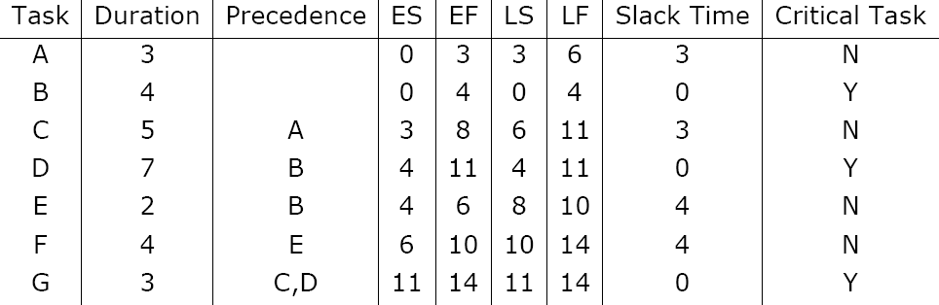
CONSTRUCTING GANTT CHART
Example of an early GANTT chart construction:

Slide 48
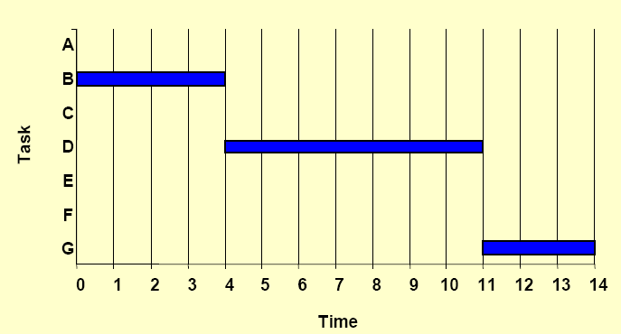
Step 1. Schedule critical tasks:

Slide 49
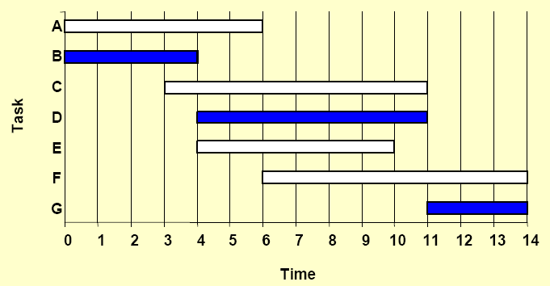
Step 2. Place time windows for non-critical tasks:

Slide 50
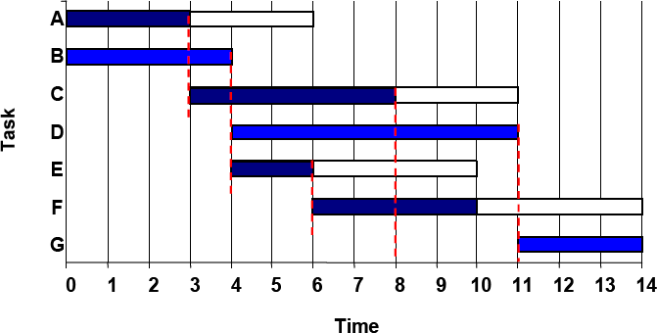
Step 3. Schedule non-critical tasks
Step 4. Indicate precedence relationships:

Slide 51
STAFFING & RE-SCHEDULING
Once the project schedule, (e.g. GANTT chart), has been
constructed, take into account
available staff hours
slack times and
the project schedule
Assign staff and other resources to each activity in the project

Slide 52


STAFFING & RE-SCHEDULING
Resource Smoothing is a technique used to re-allocate
resources and re-schedule activities.
In resource smoothing, non-critical tasks are re-scheduled within their time window.
Staff Utilization:(duration of activity x staff required for each activity, all added together) / (maximum staff required x duration of project)

Slide 53

STAFFING & RE-SCHEDULING
Example1

Slide 54
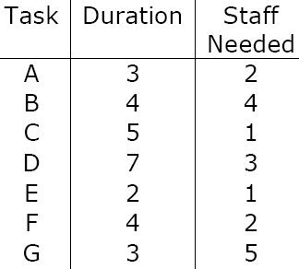
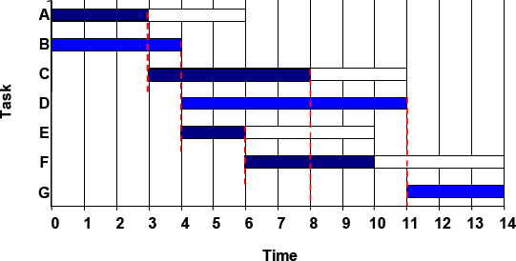
STAFFING & RE-SCHEDULING
The original schedule (constructed above) for this project is as shown below.
1. Staff utilisation :(duration of activity x staff required for each activity, all added together) / (maximum staff required x duration of project)
= (3x2+4x4+5x1+7x3+2x1+4x2+3x5)/(14x6) = 0.857 = 85.5%

Slide 55
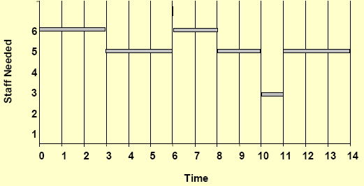
STAFFING & RE-SCHEDULING
2. Work out the Staff Profile

Slide 56
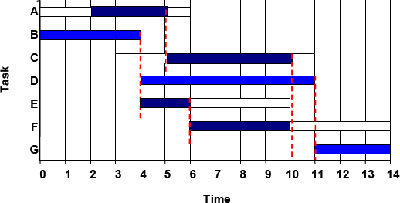
STAFFING & RE-SCHEDULING
Now, assume that there are 6 people available for working in this project but one of them returns from holidays at time=2.
So re-scheduling is needed because activities A and B cannot be carried out in parallel until time=2.

Slide 57
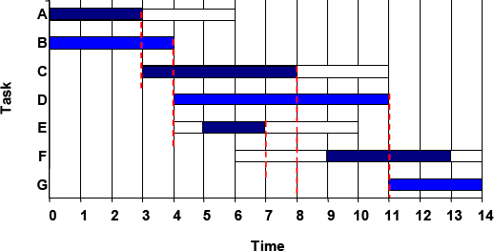
STAFFING & RE-SCHEDULING
Suppose another scenario in which equipment and materials needed to carry out activities E and F are available at time=5 and time=9 respectively instead of being available at the activities ES time. Then, rescheduling is needed but the overall duration of the project is not affected.

